Slide 1
Lecture 26
Qualitative Independent Variables in Linear Regression
Prediction
Analysis of Residual
The Multicollinearity Issue

Slide 2
Classification of Qualitative Variables
Nominal Variable: the data for the variable consist of labels or names used to group the observations into categories, and the order or rank of the data is not meaningful.
  E.g. Gender: Male, Female
Ordinal Variable: the data exhibit the properties of nominal data and the order or rank of the data is meaningful.
  E.g. Satisfaction Score: Very Unsatisfied, Unsatisfied, Average, Satisfied, Very Satisfied
Notes:
dfghdfghfdghgfhdfghdfgh

Slide 3
Ordinal Independent Variables in Multiple Linear Regression
Code the ordinal variable into values such as 0,1,2,…, and then treat the variable as quantitative. This is the often adopted approach.
Treat the ordinal variable as nominal variable and use the approach that we will be discussing.
Notes:
dfghdfghfdghgfhdfghdfgh

Slide 4
Nominal Independent Variables in Multiple Linear Regression
In many real-life situations one or more independent variables are nominal.
Including nominal variables in a regression analysis model is done via dummy variables (哑变量).
A dummy variable (I) can assume one out of two values, “zero” or “one”.
1 if a first condition out of two is met
0 if a second condition out of two is met
I=

Slide 5
1 if data were collected before 1980
0 if data were collected after 1980
1 if the person is female
0 if the person is male
1 if a degree earned is in Finance
0 if a degree earned is not in Finance

Slide 6
Example: Car Price
The dealer believes that color is a variable that affects a car’s price.
Three color categories are considered:
  White
  Silver
  Other colors
Note: Color is a nominal variable.

Slide 7
Example: Car Price
I₁ =
1 if the color is white
0 if the color is not white
I₂ =
1 if the color is silver
0 if the color is not silver
And what about “Other colors”? Set I₁ = 0 and I₂ = 0

Slide 8

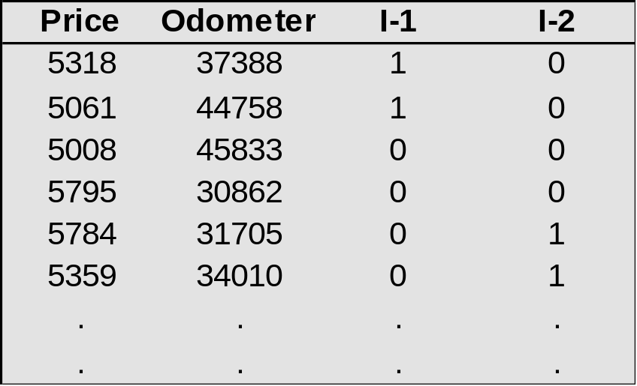
To represent a nominal variable that has k possible categories, we must create k-1 dummy variables.
Solution
  the proposed model is
  y = β₀ + β₁(Odometer) + β₂I₁ + β₃I₂ + ε
  The data
里程表
White car
Other color
Silver color

Slide 9
From Excel we get the regression equation
PRICE = 6350-.0278(ODOMETER)+45.2I₁+148I₂
For one additional mile the auction price
decreases by 2.78 cents.
A white car sells, on the average,
for $45.2 more than a car of the “Other color” category
Price
A silver color car sells, on the average,
for $148 more than a car of the “Other color” category
The equation for a
car of silver color
6498 - .0278(Odometer)
Price = 6350 - .0278(Odometer) + 45.2(0) + 148(1)
The equation for a
car of white color
6395.2 - .0278(Odometer)
The equation for a
car of the “Other color”
category.
Price = 6350 - .0278(Odometer) + 45.2(1) + 148(0)
6350 - .0278(Odometer)
Price = 6350 - .0278(Odometer) + 45.2(0) + 148(0)
Odometer

Slide 10
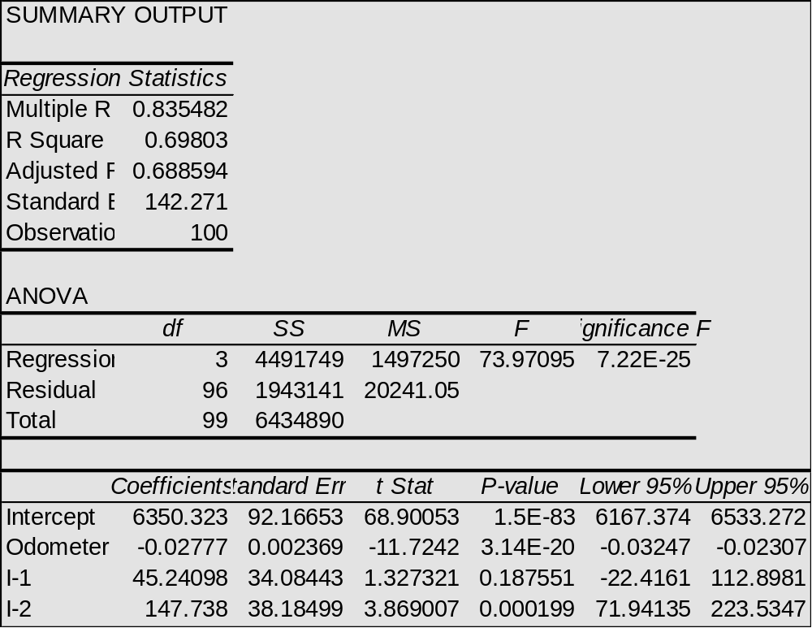
There is insufficient evidence
to infer that a white color car and
a car of “Other color” sell for a
different auction price.
There is sufficient evidence
to infer that a silver color car
sells for a larger price than a
car of the “Other color” category.

Slide 11
Point Prediction
What is the point estimate of the mean selling price for all silver cars with odometer value of 40000?
What is the point estimate of the selling price for an individual silver car with odometer value of 40000?

Slide 12
Confidence Interval vs Prediction Interval
What is the 95% interval estimate for the mean selling price for all silver cars with odometer value of 40000?
What is the 95% interval estimate for the selling price for an individual silver car with odometer value of 40000?

Slide 13
Confidence Interval vs Prediction Interval
新观测值的预测值
新观 拟合值
测值 拟合值 标准误 95% 置信区间 95% 预测区间
1 5387.3 32.2 (5323.4, 5451.2) (5097.7, 5676.8)
新观测值的自变量值
新观
测值 Odometer I-1 I-2
1 40000 0.000000 1.00

Slide 14
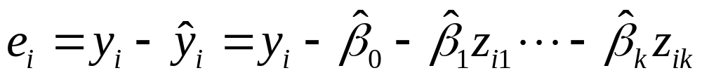

Analysis of Residuals
Check the four modeling assumptions of the multiple linear model using the residuals
Residual plots:
  plot e against each zj
  plot e against fitted value
  If the time of each measurement is available, plot e against time to see whether there is time dependence
  Normal plot

Slide 15
Example: Weather and Sales of Lift Tickets
  How does the weather affect the sales of lift tickets in a ski resort?
  Data of the past 20 years sales of tickets, along with the total snowfall and the average temperature during Christmas week in each year, was collected.
  The model hypothesized was
TICKETS=β₀+β₁SNOWFALL+β₂TEMPERATURE+ε
  Regression analysis yielded the following results:

Slide 16
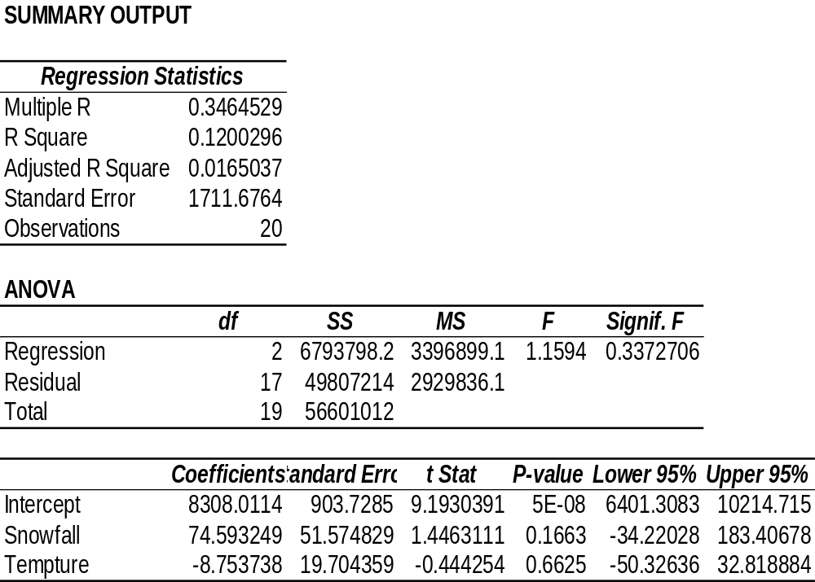
The model seems to be very poor:
The fit is very low (R-square=0.12),
It is not valid (Signif. F =0.33)
No variable is linearly related to Sales

Slide 17
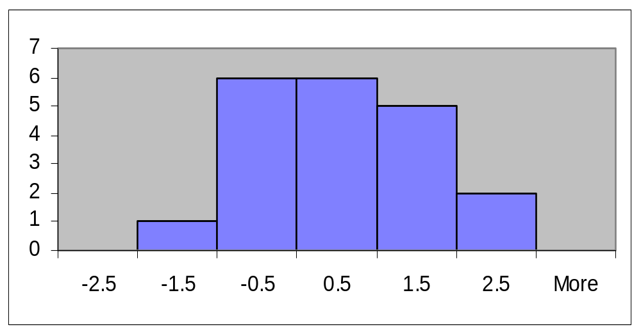
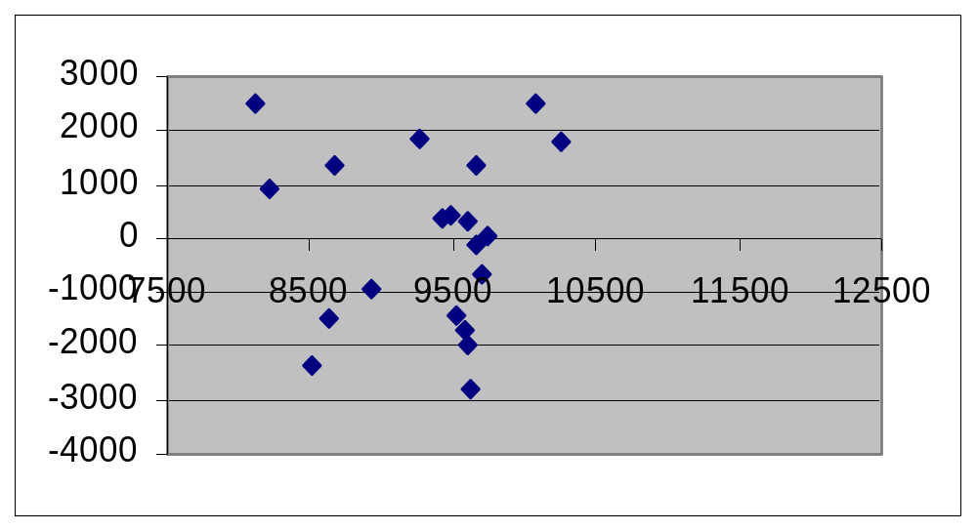
Analysis of Residuals
The errors may be
normally distributed
Residual vs. predicted y
The error variance
may be constant

Slide 18
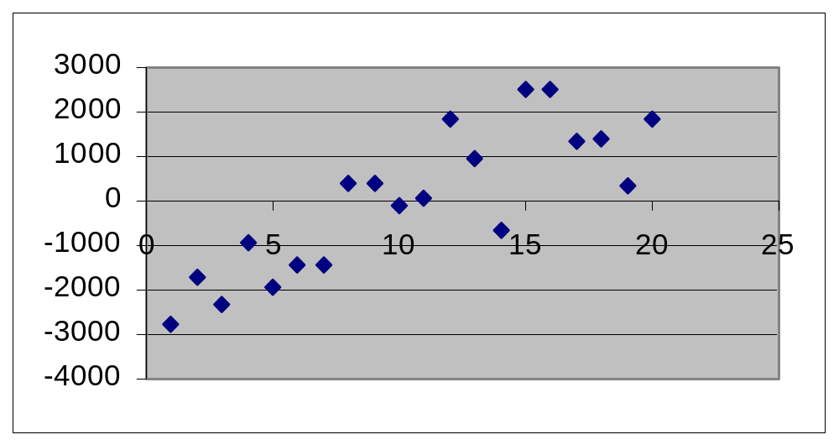
Residual over time
The errors are
NOT independent

Slide 19

A time dependent variable added
to the model may correct the problem.
The modified regression model
TICKETS=β₀+ β₁SNOWFALL+ β₂TEMPERATURE+ β₃YEARS+ε
All the required conditions are met for this model.
The fit of this model is high R² = 0.74.
The model is useful. Significance F = 5.93 E-5.
SNOWFALL and YEARS are linearly related to ticket sales.
TEMPERATURE is not linearly related to ticket sales.

Slide 20
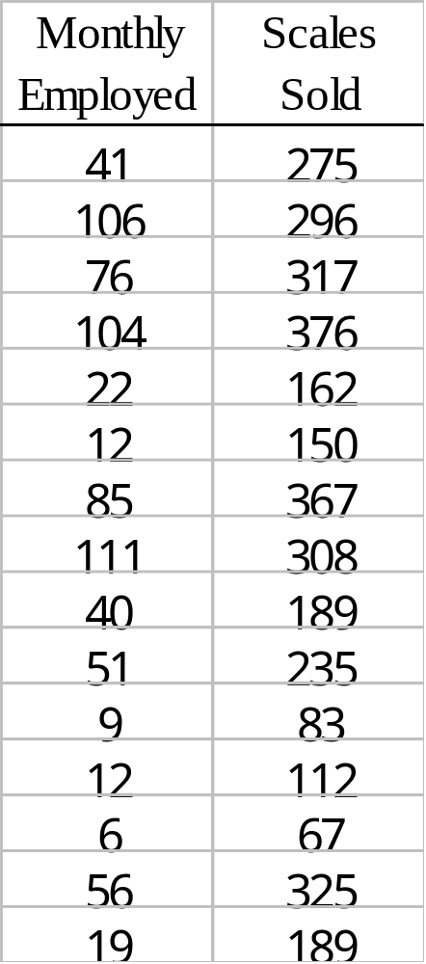
Example: Reynolds, Inc.
Reynolds, Inc., manufactures industrial scales and laboratory equipment. Managers at Reynolds want to investigate the relationship between length of employment of their saleperson and the number of electronic laboratory scales sold.

Slide 21
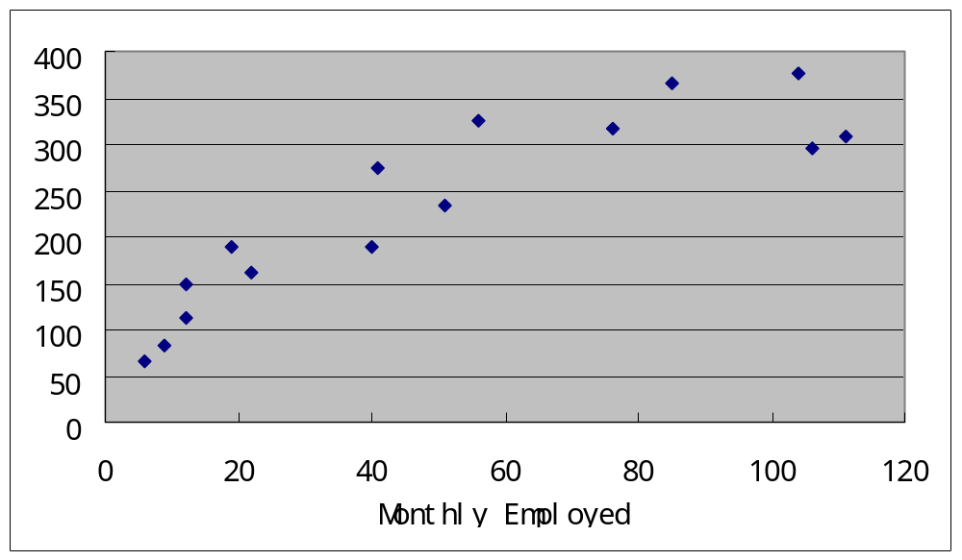
Scatter Diagram

Slide 22
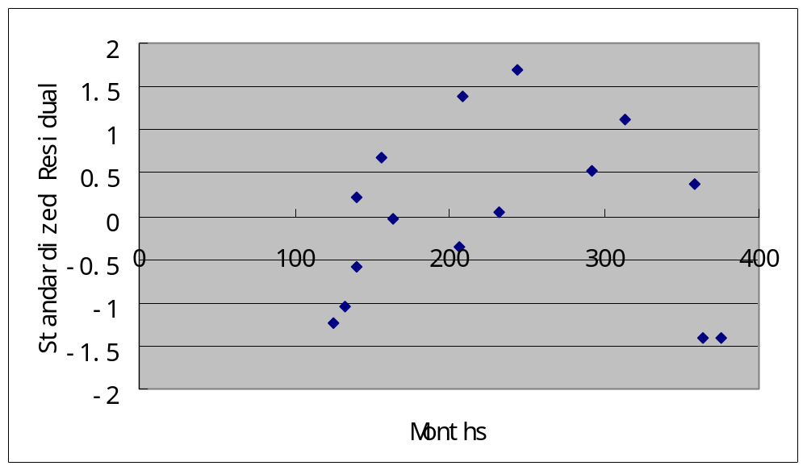
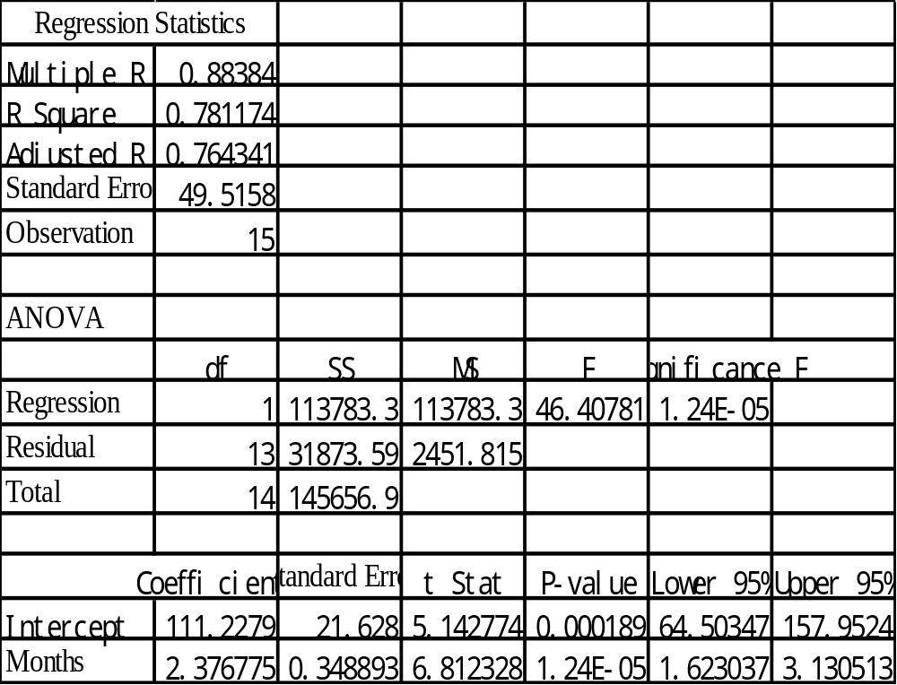

Slide 23


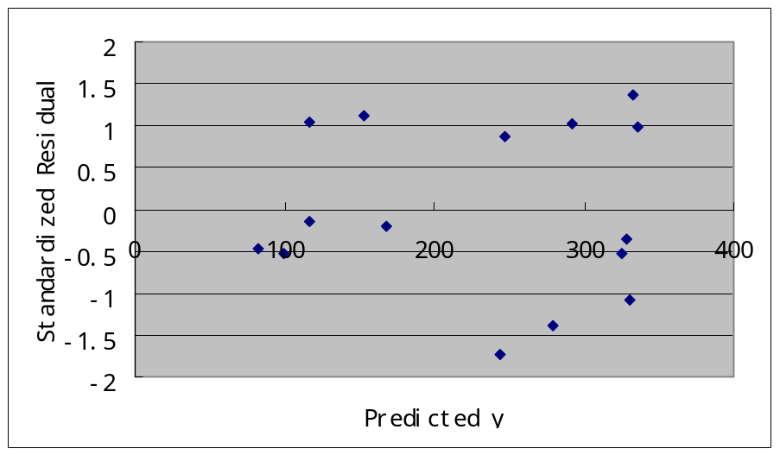
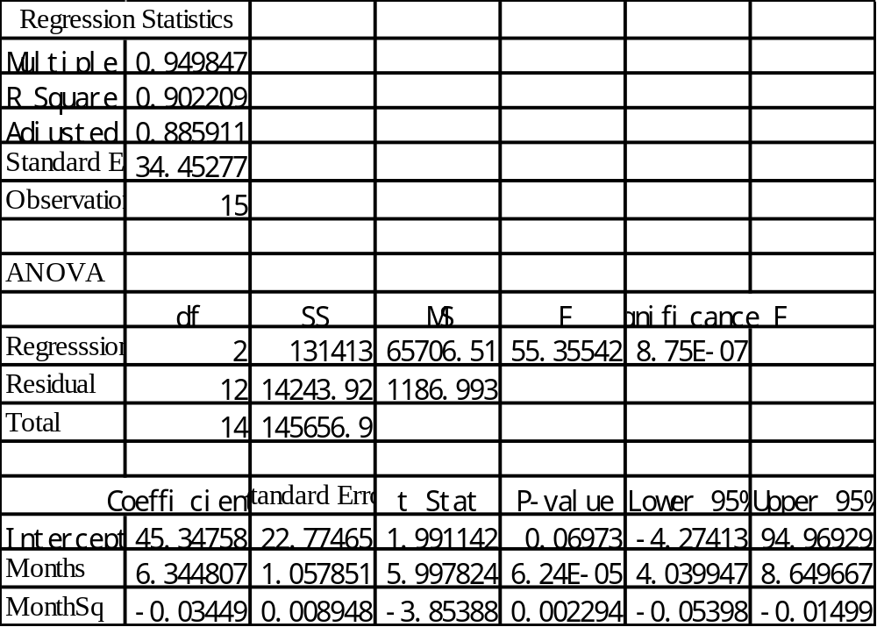
Dealing with The Nonlinear Pattern
Let

Slide 24
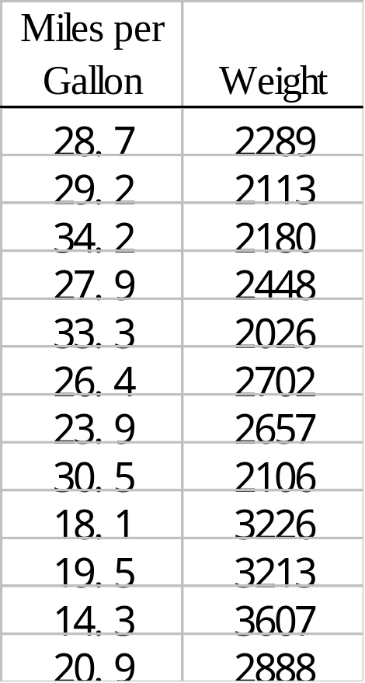
Example: Automobiles
The miles per gallon ratings and weights for 12 automobiles are recorded:

Slide 25
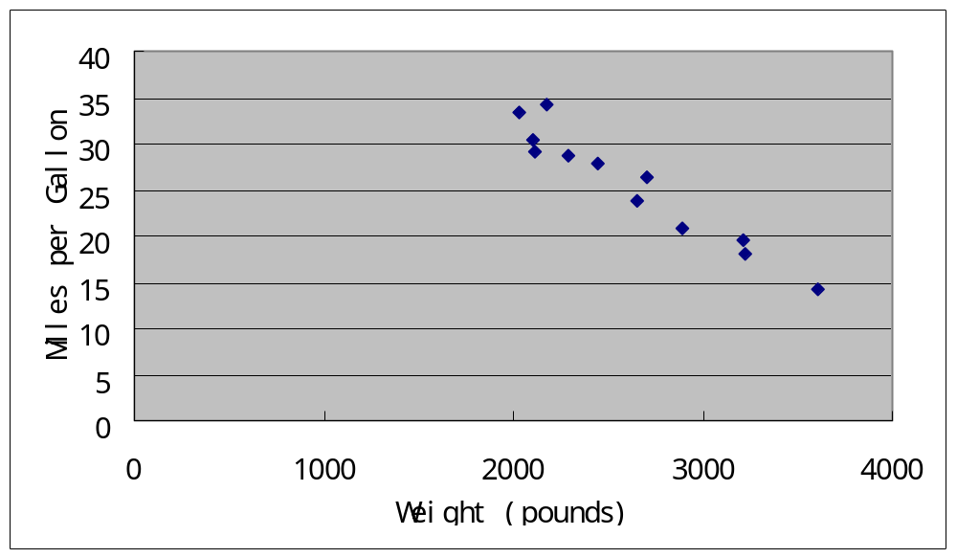
Scatter Plot

Slide 26
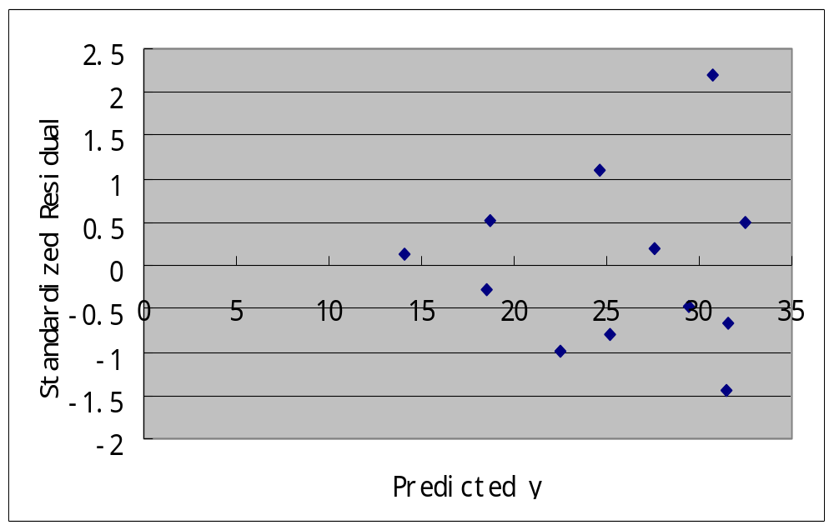
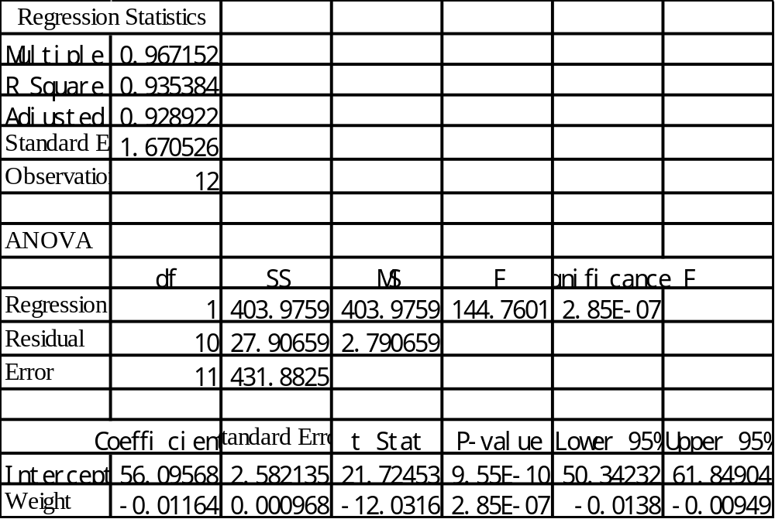

Slide 27
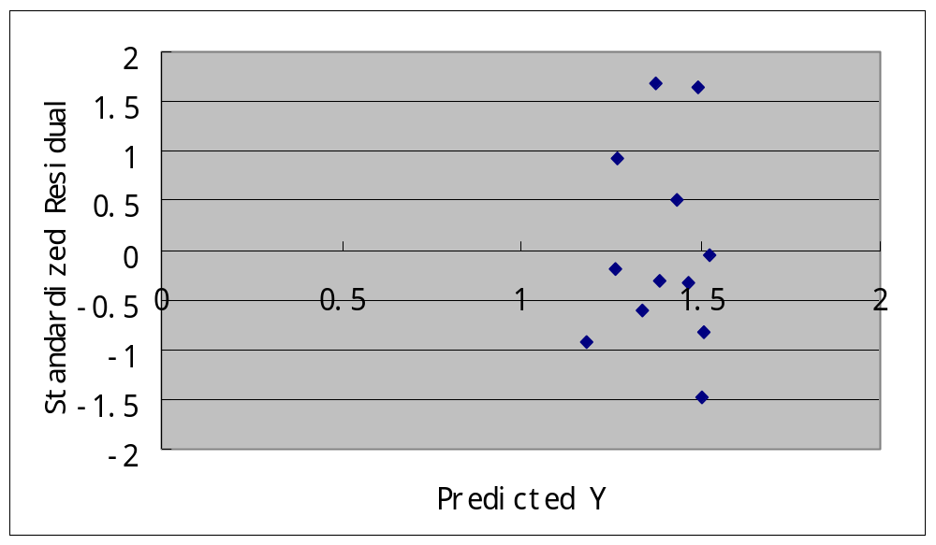
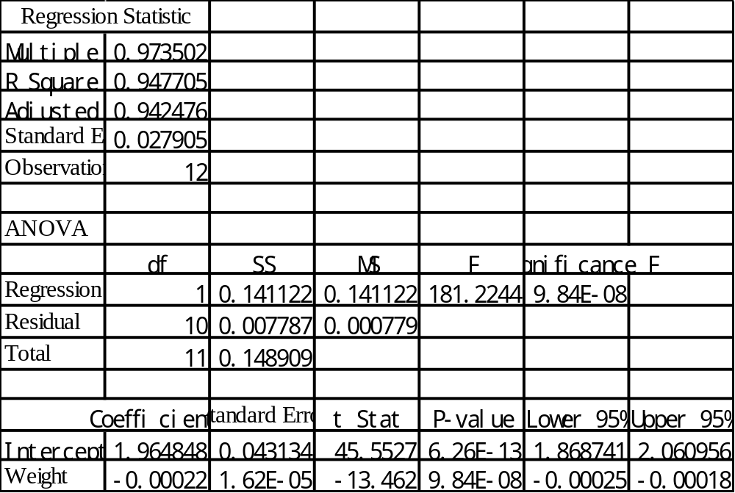
Transform the Dependent Variable
Let y’=log(y) be the dependent variable.

Slide 28
Question
What does it mean for y’=log(y) to decrease by 0.00022 unit?

Slide 29
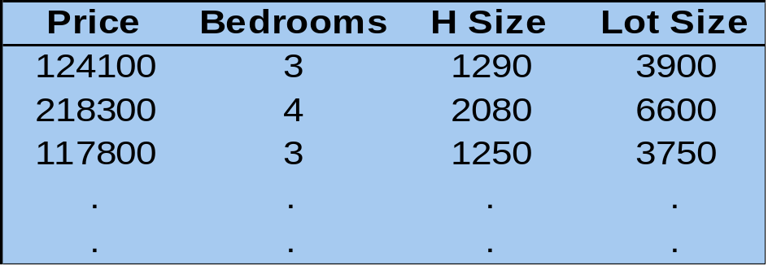
The Multicollinearity Issue
Example: House price
  A real estate agent believes that a house selling price can be predicted using the house size, number of bedrooms, and lot size.
  A random sample of 100 houses was drawn and data recorded.

Slide 30
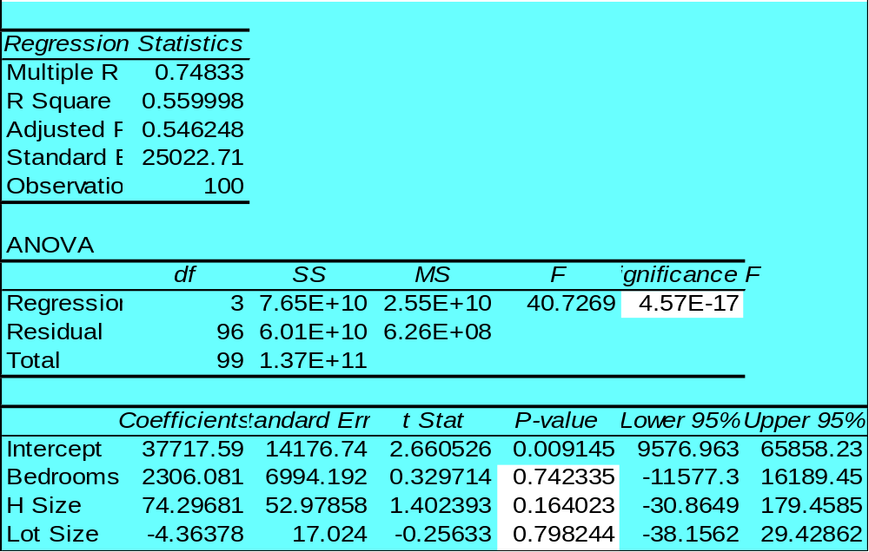

The proposed model is
PRICE = β₀ + β₁BEDROOMS + β₂H-SIZE +β₃LOTSIZE + ε
  Excel solution
The model is valid, but no
variable is significantly related
to the selling price !!

Slide 31
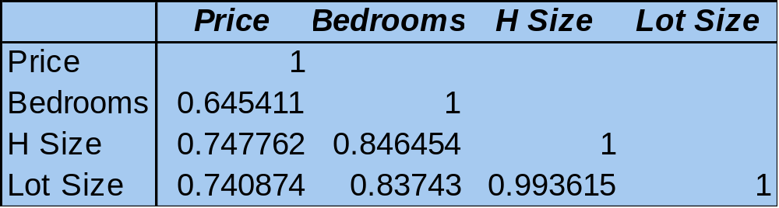
  However, when regressing the price on each independent variable alone, it is found that each variable is strongly related to the selling price.
Multicollinearity is the source of this problem.
Correlation matrix:

Slide 32
More subtle case: one of the independent variables can almost be expressed as linear combinations of other independent variables.
We can regress each independent variable on the other independent variables, and if the resulting R-square is high, then there exists multicollinearity.

Slide 33
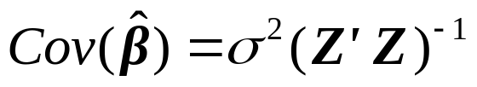

More on the Multicollinearity Issue
Theoretical Reason:
If there is a multicollinearity problem, will be close to a singular matrix, therefore the variances of the estimators for the coefficients will be large
Multicollinearity causes two kinds of difficulties:
  The t statistics appear to be too small.
  The coefficients cannot be interpreted as “slopes”.

